Slide 1
Musimorph & Hydrizon : A Comparative Analysis of Content Growth and Engagement Strategies
Presented By
BIBEK LAMSAL

Slide 2
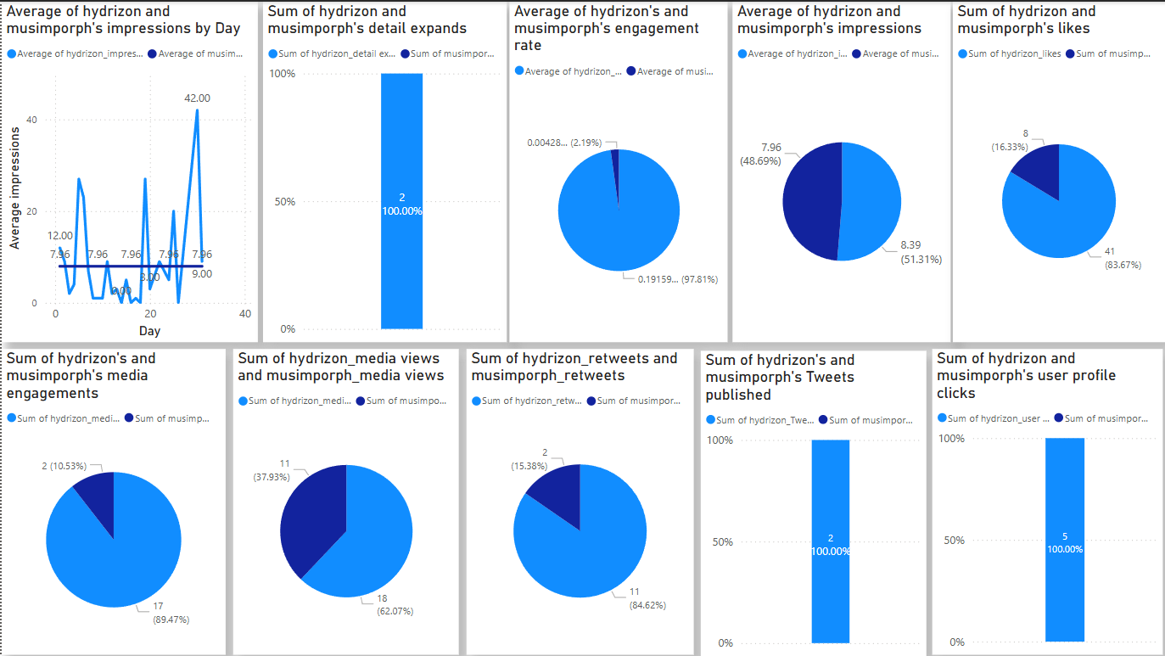
Visualization using dashboard

Slide 3
Insight:
Hydrizon and Musimorph have similar average impressions per day, but Hydrizon exhibits higher peaks, suggesting occasional viral spikes in engagement.
Hydrizon dominates in detail expands (100%), indicating that users are more curious about its content.
Hydrizon has a higher average engagement rate (97.81%) compared to Musimorph (2.19%), indicating that Hydrizon's content is more engaging and resonates better with its audience.
Hydrizon has slightly more impressions (51.31%) compared to Musimorph (48.69%), meaning it reaches a wider audience, but engagement remains a challenge.
Hydrizon outperforms Musimorph in media engagements (89.47% vs. 10.53%), meaning its multimedia content (images, videos) receives significantly more interaction.
Hydrizon drives significantly more user profile clicks (5 times), meaning its content effectively encourages users to explore its profile, potentially leading to higher follower growth.

Slide 4
Recommandation
Enhance Engagement Strategies: Since Musimorph has a higher reach (impressions) but lower engagement (likes, retweets, and profile clicks), it should focus on interactive content like polls, Q&A sessions, and call-to-action posts to encourage audience participation.
Improve Shareability and Virality: Musimorph's retweets are significantly lower than Hydrizon’s that is (15.38% vs 84.62%). To increase shareability, it should create trend-driven, relatable, and visually appealing content that encourages users to share and engage organically.
Leverage Multimedia Content: Musimorph’s media engagements and views are lower than Hydrizon’s that is (10.53% vs 89.47%). It should focus on high-quality images, videos, and infographics to make its content more visually engaging and drive higher interaction rates.

Slide 5
Call Through Action
Let’s schedule a meeting with the content creator team to address Musimorph’s lower media engagement and views compared to Hydrizon (10.53% vs. 89.47%).I would recommend to focus on high-quality images, videos, and infographics to make its content more visually engaging and drive higher interaction rates for gaining more views and subscribers.

